Slide 1


Digital Skill Fair 35.0 Data Science
"LINNERUD DATASET MACHINE LEARNING PROJECT USING LINEAR REGRESSION"
DEWI YULIANA

Slide 2

ABOUT ME
"I am a dedicated physics student at the State Islamic University of Sunan Gunung Djati Bandung, specializing in robotic instrumentation physics and computational methods. With a solid foundation in Python, SQL data analysis, and artificial intelligence, I am passionate about bridging the gap between theoretical concepts and real-world applications. I have hands-on experience in AI, machine learning, and Python programming, and I’m continuously seeking opportunities to expand my knowledge in data science. "

Slide 3



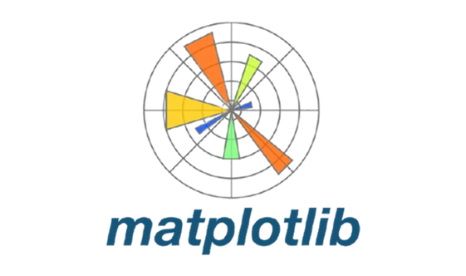
TOOLS USED

Slide 4
ABOUT THE PROJECT
This project focuses on analyzing the Linnerud dataset using linear regression, a fundamental machine learning technique. The Linnerud dataset consists of physical exercise data, including features such as chin-ups, sit-ups, and jumps, along with health-related targets like weight, waist circumference, and pulse. The goal is to apply linear regression to predict health metrics based on exercise data and evaluate the model's performance.

Slide 5
TABLE OF CONTENT
01
03
Library and Dataset
Model
02
04
Exploratory Data
Predict & Evaluate

Slide 6
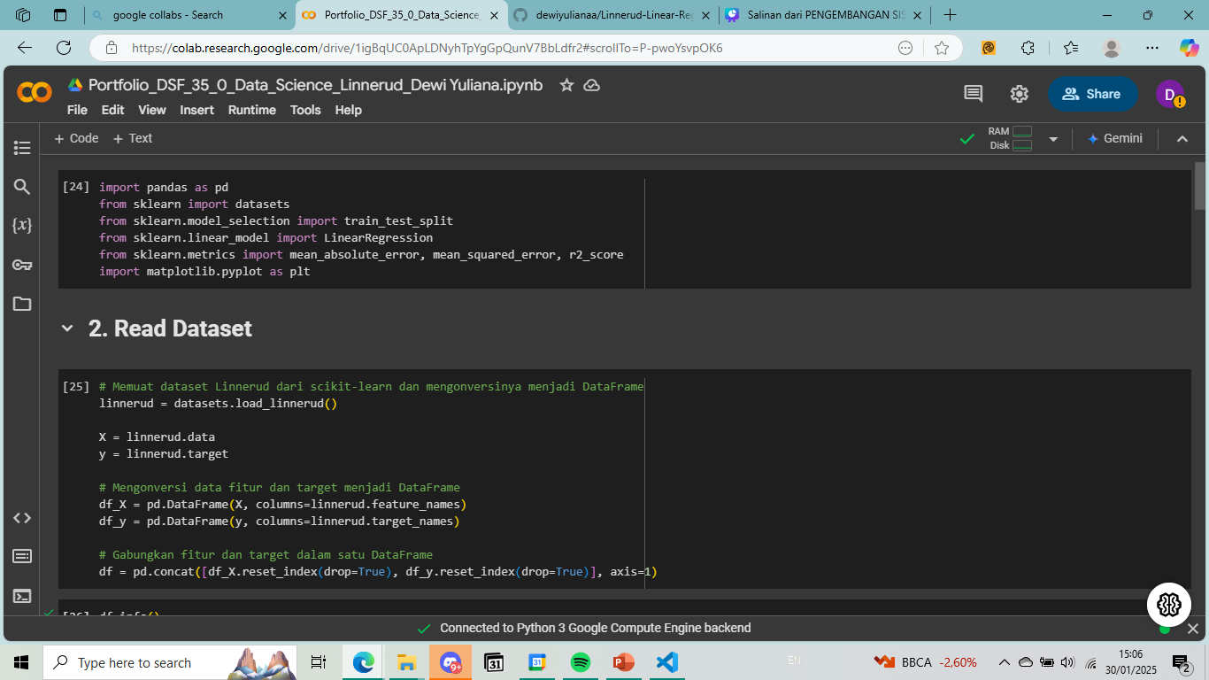
LIBRARY AND DATASET
pandas: Used for data manipulation in DataFrame format.
numpy: Used for numerical operations and array handling.
sklearn.datasets: For loading predefined datasets provided by scikit-learn.
sklearn.model_selection.train_test_split: To split data into training and testing sets.
sklearn.linear_model.LinearRegression: To create and train a linear regression model.
sklearn.metrics: Used for evaluating the model (Mean Absolute Error, Mean Squared Error, R2 Score).
matplotlib.pyplot and seaborn: Used for data visualization (heatmaps and scatter plots).
The Linnerud dataset is loaded, which contains physical exercises data used to predict certain health metrics.
X: The input features (e.g., exercises like sit-ups, cycling, etc.).
y: The target outputs (e.g., variables like body weight, number of sit-ups, etc.).
The data is then converted into a DataFrame for easier manipulation.

Slide 7
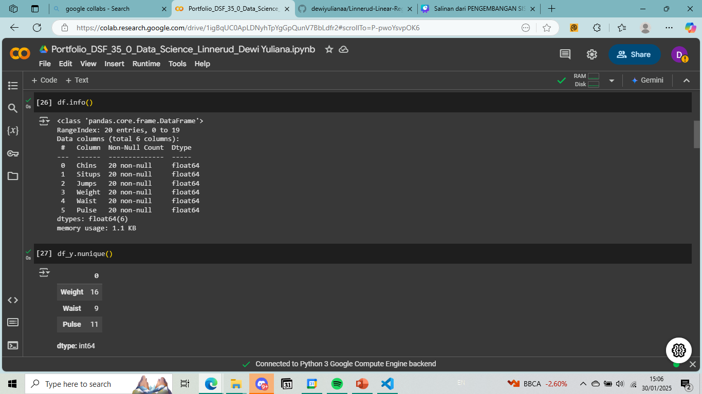
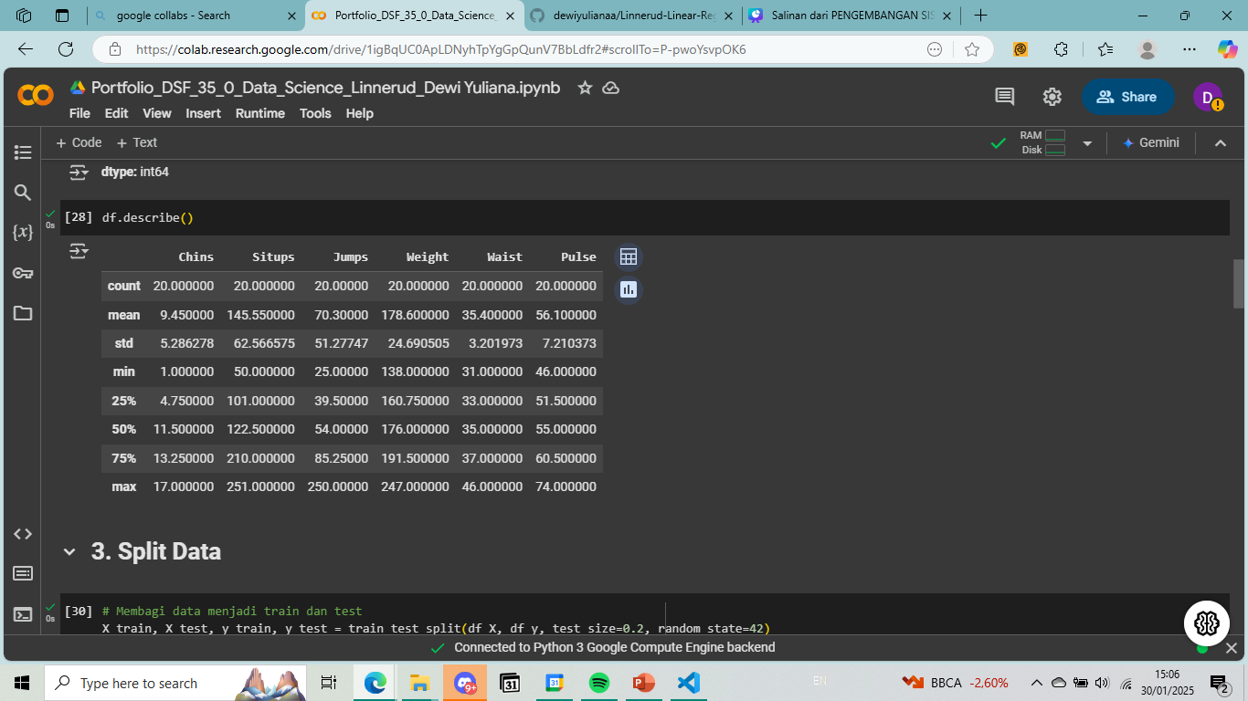
EXPLORATORY DATA
d.info() provides details about the dataset, including data types and the number of non-null entries.
.describe() provides statistical summaries (mean, standard deviation, min, max, etc.) for each column.

Slide 8
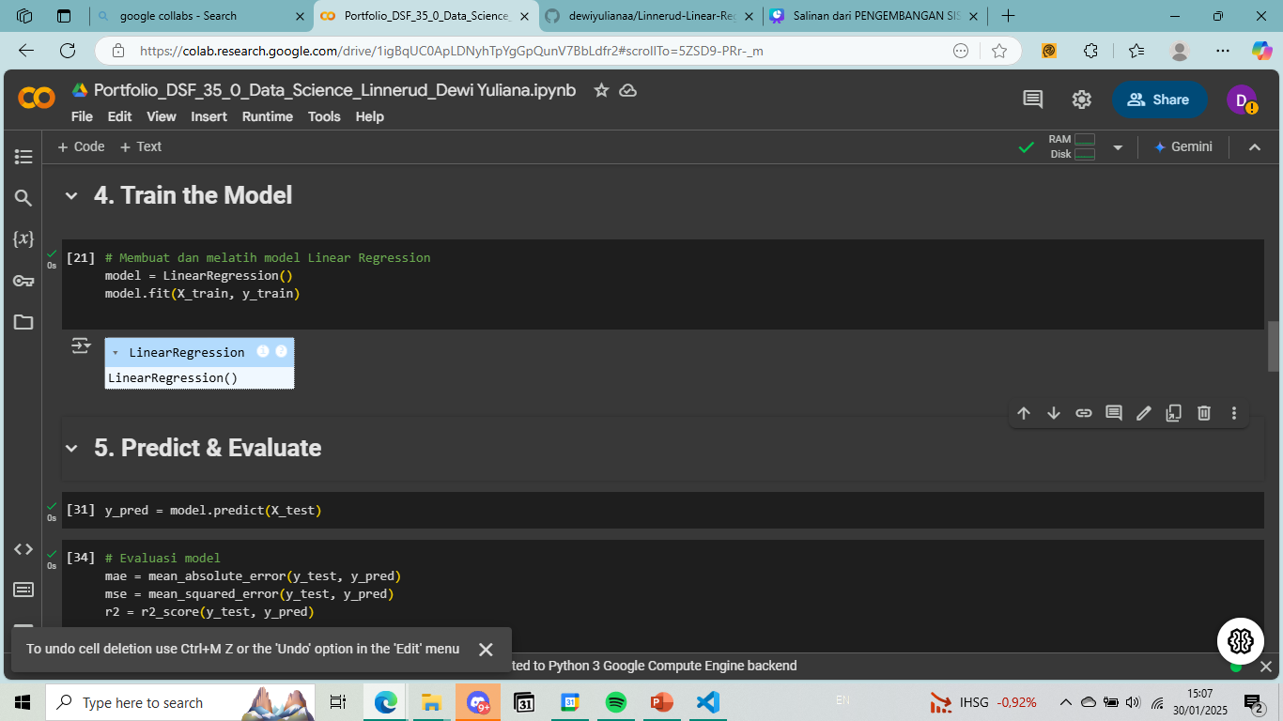
MODEL
A LinearRegression model is created.
The .fit() method trains the model using the training data (X_train, y_train).
Linear
Regression
Linear Regression is a simple yet powerful algorithm used for predicting a continuous target variable based on one or more input features. In the context of the project above, the model is applied to predict multiple target variables from the Linnerud dataset using a linear relationship between the features and the targets.

Slide 9
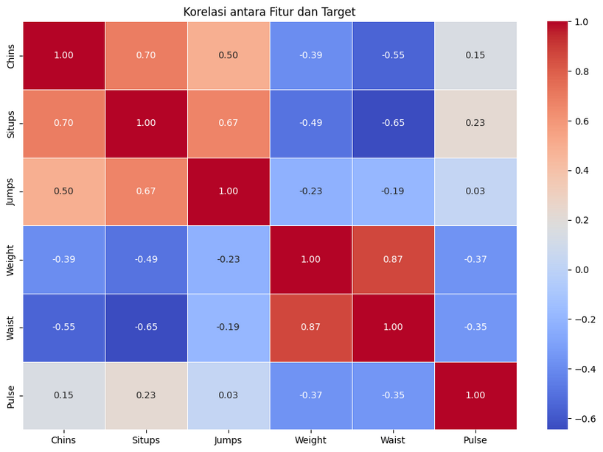
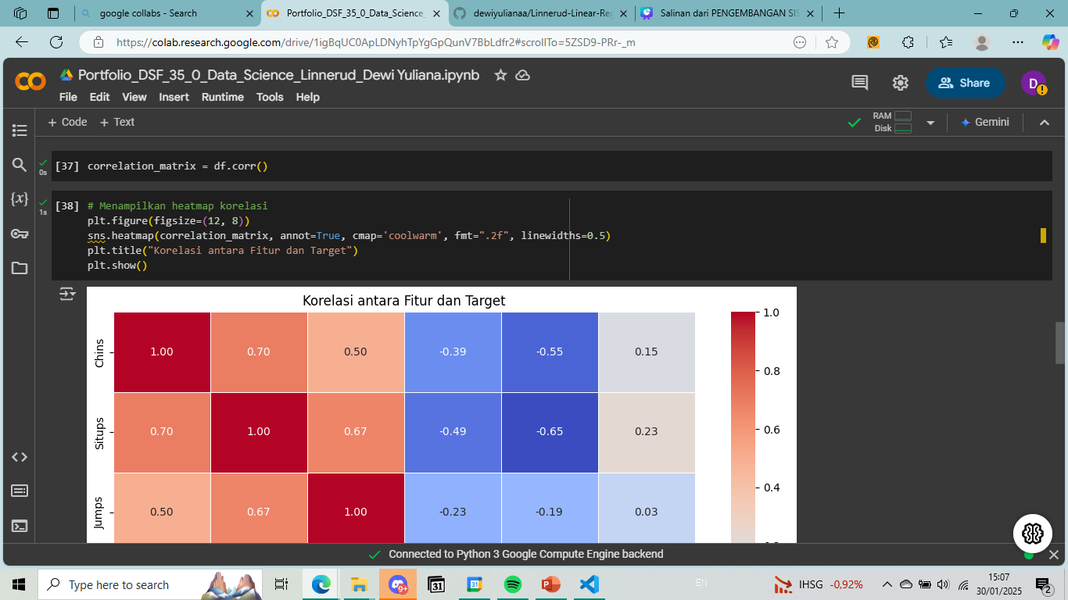
PREDICT AND EVALUATE
Correlation Heatmap
The .corr() function calculates the correlation matrix between features and targets.
sns.heatmap() visualizes the correlation matrix, where the color intensity represents the strength of the correlation.

Slide 10
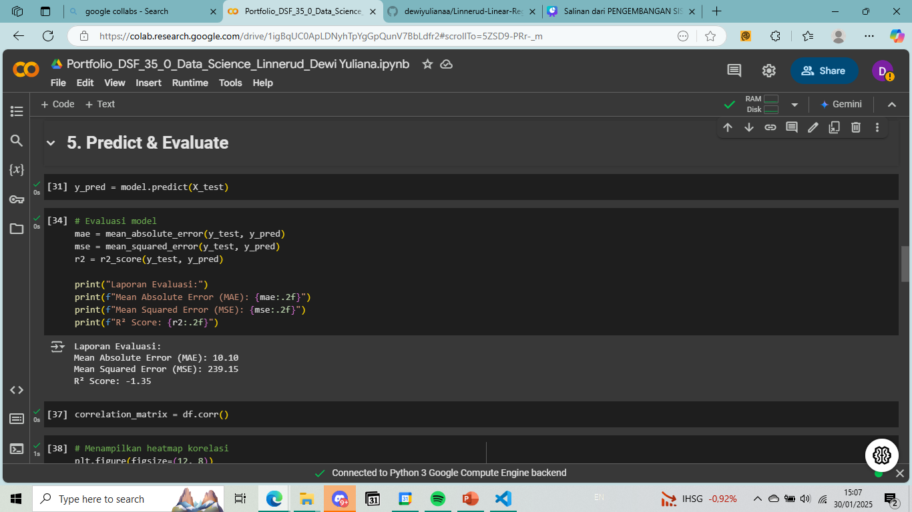
PREDICT AND EVALUATE
Model Evaluation
Mean Absolute Error (MAE): The average of the absolute differences between actual and predicted values.
Mean Squared Error (MSE): The average of the squared differences between actual and predicted values.
R2 Score: A measure of how well the model explains the variance in the target variable (range from 0 to 1).

Slide 11
PREDICT AND EVALUATE
Model Evaluation
Mean Absolute Error (MAE): The average of the absolute differences between actual and predicted values.
Mean Squared Error (MSE): The average of the squared differences between actual and predicted values.
R2 Score: A measure of how well the model explains the variance in the target variable (range from 0 to 1).

Slide 12
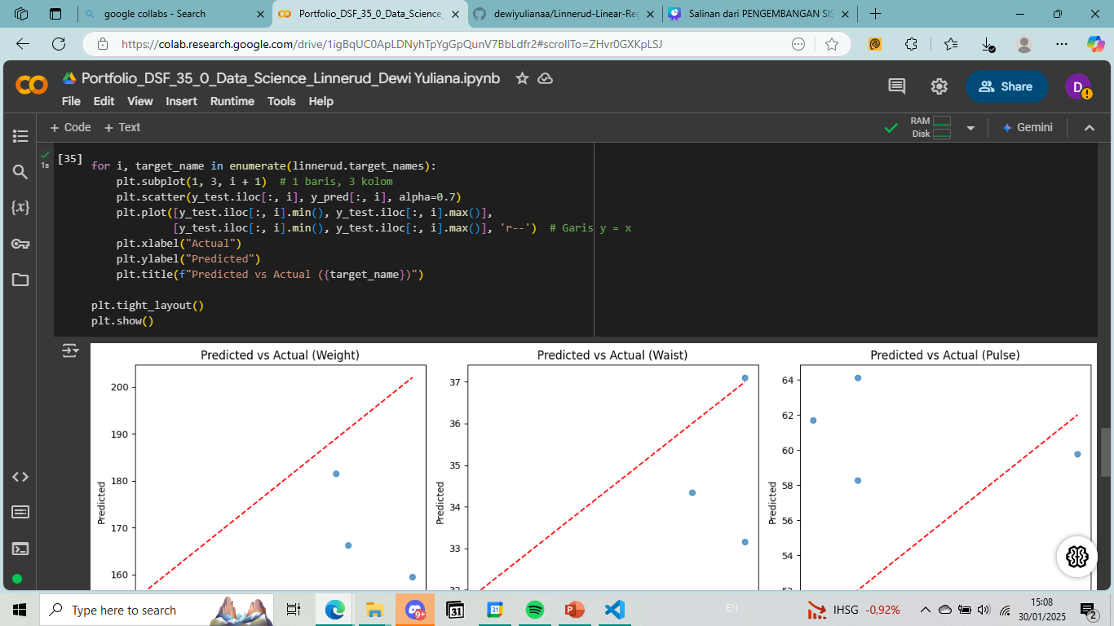
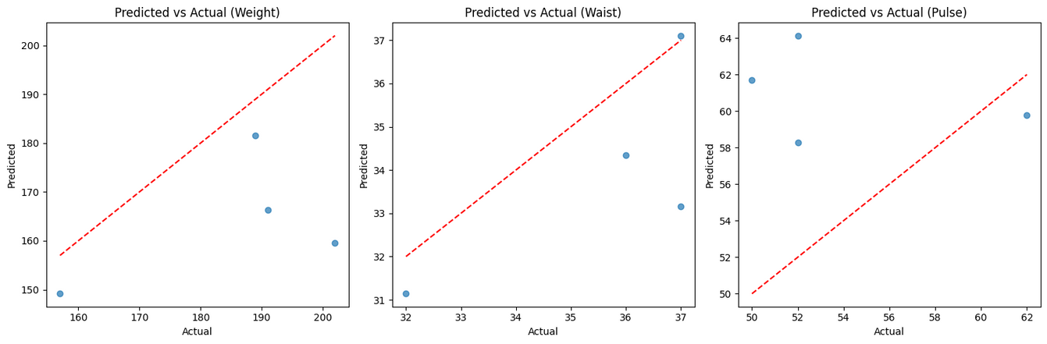
PREDICT AND EVALUATE
For each target variable, a scatter plot is created that compares the actual values (y_test) to the predicted values (y_pred).
A red dashed line (y=x) is drawn to indicate where perfect predictions would lie.
The plots are displayed for each target variable in the dataset.

Slide 13


THANK YOU
www.linkedin.com/in/dewiyuliana1507
dewiyulianaa938@gmail.com
@dhyli_ana

